Slide 1
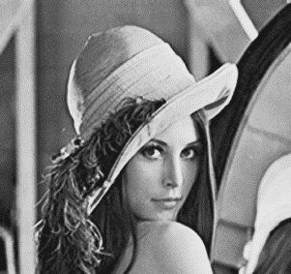
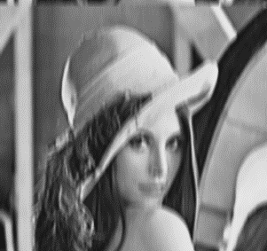

Imaginile preluate de senzori: perturbate/degradate → restaurare
?
Model de degradare: liniar $g=\left(h⊗f\right)+η$ $\hat{g}=\hat{h}⋅\hat{f}+\hat{η}$
?
?
Imagine
Imagine $⨂$ impuls (perturbare) + zgomot ⇨ imagine degradată
Imagine $⨂$ impuls (perturbare)

Slide 2


Restaurare = obținerea unei aproximări a imaginii „corecte”
Estimare tip și parametri zgomot
→ eliminare (reducere) zgomot
Estimare tip perturbare
→ eliminare (reducere) perturbare
Estimare grad de similaritate
→ cît de bun este rezultatul

Slide 3
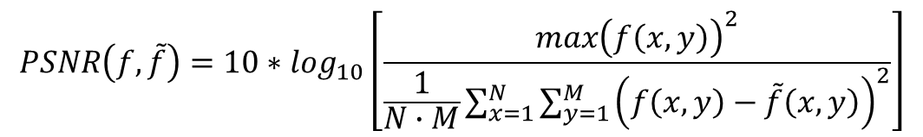
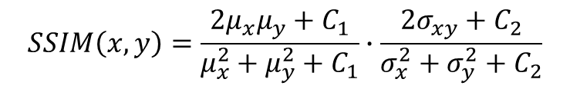
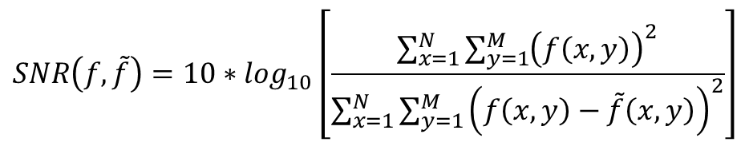
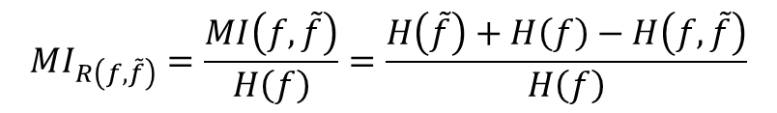
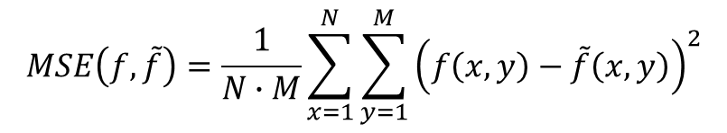
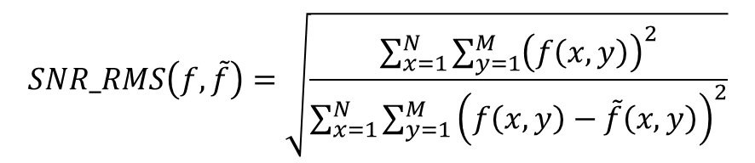
Indicatori estimare calitate
raportul semnal-zgomot (SNR)
raportul vîrf-semnal-zgomot (Peak-SNR)
raportul semnal-zgomot rădăcină medie pătratică (SNR-RMS)
eroarea medie pătratică (MSE)
raportul de informație mutuală (RMI)
metrica similaritate structurală (SSIM)
$$SNR\left(f,\tilde{f}\right)=10∗\log_{10}\left[\frac{\sum_{x=1}^{N}{\sum_{y=1}^{M}{{\left(f\left(x,y\right)\right)}^{2}}}}{\sum_{x=1}^{N}{\sum_{y=1}^{M}{{\left(f\left(x,y\right)−\tilde{f}\left(x,y\right)\right)}^{2}}}}\right]$$
$$PSNR\left(f,\tilde{f}\right)=10∗\log_{10}\left[\frac{max{\left(f\left(x,y\right)\right)}^{2}}{\frac{1}{N∙M}\sum_{x=1}^{N}{\sum_{y=1}^{M}{{\left(f\left(x,y\right)−\tilde{f}\left(x,y\right)\right)}^{2}}}}\right]$$
$$SNR_RMS\left(f,\tilde{f}\right)=\sqrt{\frac{\sum_{x=1}^{N}{\sum_{y=1}^{M}{{\left(f\left(x,y\right)\right)}^{2}}}}{\sum_{x=1}^{N}{\sum_{y=1}^{M}{{\left(f\left(x,y\right)−\tilde{f}\left(x,y\right)\right)}^{2}}}}}$$
$$MSE\left(f,\tilde{f}\right)=\frac{1}{N∙M}\sum_{x=1}^{N}{\sum_{y=1}^{M}{{\left(f\left(x,y\right)−\tilde{f}\left(x,y\right)\right)}^{2}}}$$
$$MI_{R\left(f,\tilde{f}\right)}=\frac{MI\left(f,\tilde{f}\right)}{H\left(f\right)}=\frac{H\left(\tilde{f}\right)+H\left(f\right)−H\left(f,\tilde{f}\right)}{H\left(f\right)}$$
$$SSIM\left(x,y\right)=\frac{2μ_{x}μ_{y}+C_{1}}{μ_{x}^{2}+μ_{y}^{2}+C_{1}}∙\frac{2σ_{xy}+C_{2}}{σ_{x}^{2}+σ_{y}^{2}+C_{2}}$$

Slide 4
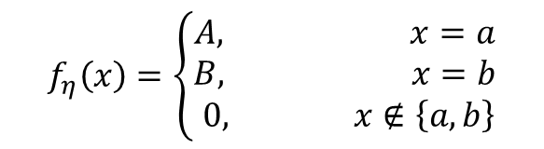
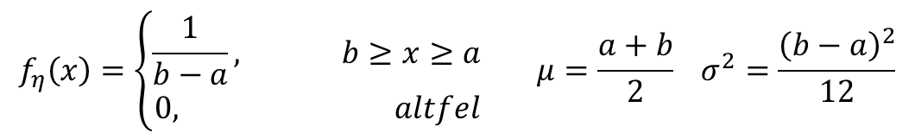
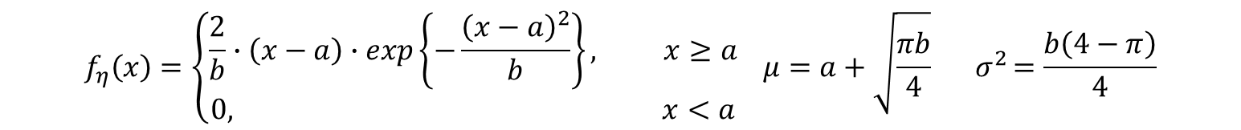
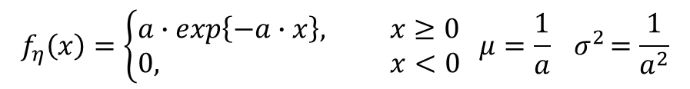
Tipuri de zgomot
gaussian: circuit electronic, senzor
sare și piper (impuls): prelucrări digitale - scalare
exponențial negativ: imagistica laser
Rayleigh: range imaging
uniform: date corupte
$$f_{η}\left(x\right)=\frac{1}{\sqrt{2πσ^{2}}}∙exp\left\{−\frac{{\left(x−μ\right)}^{2}}{2σ^{2}}\right\} E\left(η\right)=μ var\left(η\right)=E\left({\left(η−μ\right)}^{2}\right)=σ^{2}$$
$$f_{η}\left(x\right)=\left\{\begin{aligned}A, x=a \\ B, x=b \\ 0, x∉\left\{a,b\right\}\end{aligned}\right.$$
$$f_{η}\left(x\right)=\left\{\begin{aligned}a∙exp\left\{−a∙x\right\}, x≥0 \\ 0, x<0\end{aligned} μ=\frac{1}{a}{ σ}^{2}=\frac{1}{a^{2}}\right.$$
$$f_{η}\left(x\right)=\left\{\begin{aligned}\frac{2}{b}∙\left(x−a\right)∙exp\left\{−\frac{{\left(x−a\right)}^{2}}{b}\right\}, x≥a \\ 0, x<a\end{aligned} \right.μ=a+\sqrt{\frac{πb}{4}} { σ}^{2}=\frac{b\left(4−π\right)}{4}$$
$$f_{η}\left(x\right)=\left\{\begin{aligned}\frac{1}{b−a}, b≥x≥a \\ 0, altfel\end{aligned}\right. μ=\frac{a+b}{2} σ^{2}=\frac{{\left(b−a\right)}^{2}}{12}$$

